Slide 1
Simulations of a cloud falling onto SMBH binaries: formation of discs
Felipe Garrido (PUC), Jorge Cuadra (PUC), Alberto Sesana (AEI) and Takamitsu Tanaka (MPA)
IAU Symposium 312: “Black Holes and Clusters across cosmic time”
August 2014 @ Beijing

Slide 2
Galaxy Mergers and Gas
When two galaxies merge there are large amounts of gas funneled to the center of the remnant.
The large scale gas and the orbital plane are somewhat aligned.
Turbulence on the nuclear component can produce gas structures without any preferential direction.
Mayer et al. 2008

Slide 3
Binaries of SMBHs
Supermassive Black Holes (SMBHs) at the center of most massive galaxies.
Galaxy mergers will lead eventually to the formation SMBH binaries.
Do the Black Holes merge?
Mayer et al. 2007

Slide 4
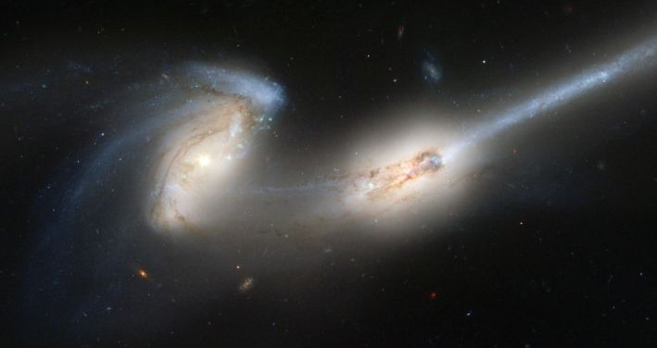
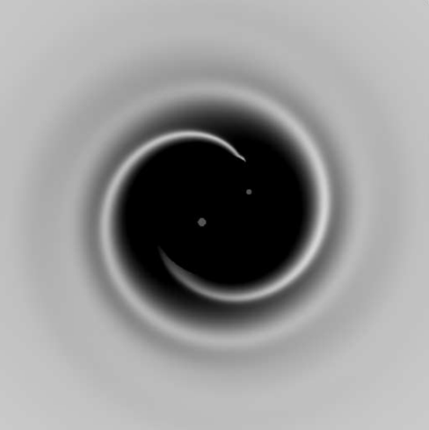
Gas and Binary Evolution
Gas is more efficient absorbing the angular momentum of the binary than stars.
Interaction with gas can drive the evolution of the SMBHs at parsec separations.
How the gas reaches the influence radius is not clear.
Luminous component!
Credit: Hubble Space Telescope
Armitage & Natarajan (2005)

Slide 5
Bonnell & Rice 2008
This simulation shows a spherical, turbulent cloud falling with very low impact parameter onto a one million solar masses BH.
Our work is to model one of these accretion events onto a binary black hole.

Slide 6
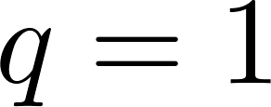
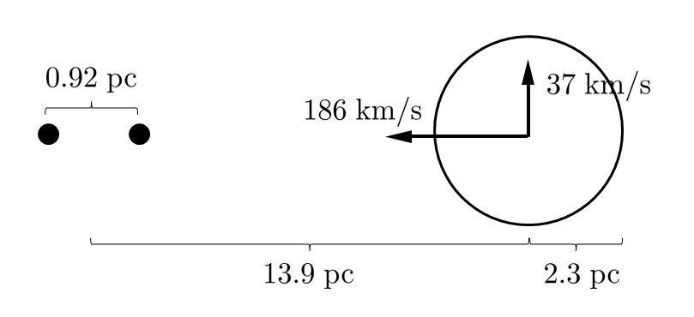
The Simulation (GADGET-3)
Cloud
Black Hole Binary
Initially turbulent, uniform density and temperature of
Circular, keplerian orbit
Eccentric bound
orbit
Pericenter distance

Slide 7
Aligned Orbits

Slide 8
Aligned orbits
Time evolution of the angular momentum direction for the mini-discs

Slide 9
Aligned orbits
Accretion rate and accreted mass onto the binary and each SMBH
cumulative

Slide 10
Aligned orbits
Energy distribution of the gas at different times

Slide 11
Perpendicular Orbits

Slide 12
Perpendicular orbits
Time evolution of the angular momentum direction for the mini-discs

Slide 13
Perpendicular orbits
Accretion rate and accreted mass onto the binary and each SMBH
cumulative

Slide 14
Perpendicular orbits
Energy distribution of the gas at different times

Slide 15
Counter-aligned Orbits

Slide 16
Counter-aligned orbits
Eccentricity evolution of the gas particles.

Slide 17
Counter-aligned orbits
Accretion rate and accreted mass onto the binary and each SMBH
cumulative

Slide 18
Counter-aligned orbits
Energy distribution of the gas at different times

Slide 19
To take home!
Different relative orientations between cloud and binary produce very different configurations:
aligned “mini” discs,
misaligned “mini” discs,
circumbinary, counter-rotating disc (ring?).
Implications on the fate and possible observability of the merging black holes.

Slide 20
Future work
Impact of accretion recipe and thermodynamics.
Observational signatures.
Evolution of the binary orbit.
Explore parameter space:
Impact parameter (pericenter distance).
Binary mass and separation.

