Slide 1
Simulations of a molecular cloud falling into binary SMBHs
Felipe Garrido and Jorge Cuadra
PUC, Chile
XI SOCHIAS Annual Meeting
January 2014

Slide 2
Binaries of SMBHs
Supermassive Black Holes (SMBHs) at the center of most massive galaxies.
Galaxy mergers will lead eventually to the formation SMBH binaries.
Do the Black Holes merge?
Mayer et al. 2007

Slide 3
Galaxy Mergers and Gas
When two galaxies merge there are large amounts of gas funnelled to the center of the remnant.
The large scale gas and the orbit plane are somewhat aligned.
Turbulence on the nuclear component can produce gas structures without any preferential direction.
Mayer et al. 2008

Slide 4
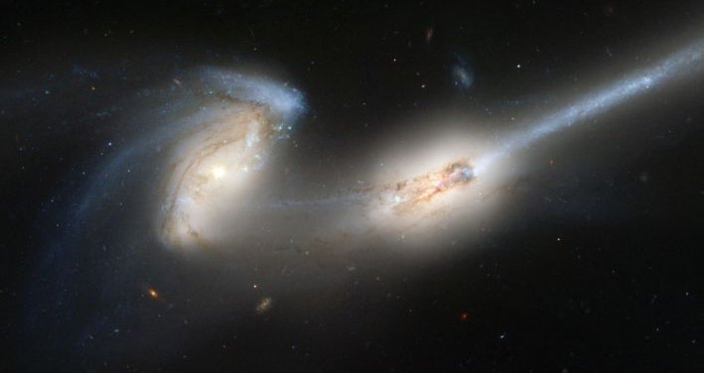
Gas and Binary Evolution
Gas is more efficient absorbing the angular momentum of the binary than stars.
Interaction with gas can drive the evolution of the SMBHs at parsec separations.
Provides a luminous component.
How the gas reaches the influence radius is not clear.

Slide 5
Without turbulence
Simulation of Hobbs et al. (2011) to study the importance of velocity dispersion in the gas at large distances from the BH.
“Ballistic accretion”
Turbulence randomize the direction of the accretion events.
With turbulence

Slide 6
Bonnell & Rice 2008
This simulation shows a spherical, turbulent cloud falling with very low impact parameter onto a one million solar masses BH.
Our work is to model one of these accretion events onto a binary black hole.

Slide 7
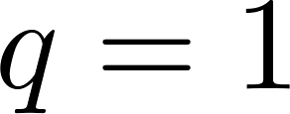
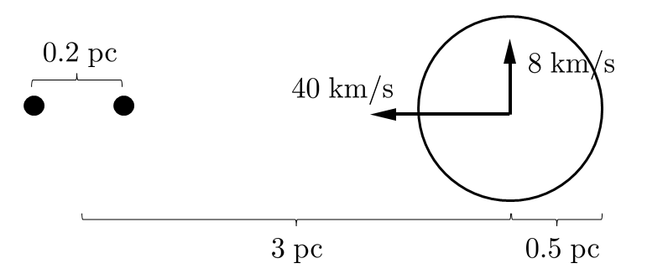
The Simulation (GADGET-3)
Cloud
Black Hole Binary
Initially turbulent, uniform density and temperature of .
Circular, keplerian orbit
Eccentric bound
orbit
Pericenter distance

Slide 8
Aligned Orbits

Slide 9
Aligned orbits
Time evolution of the angular momentum direction for the mini-discs

Slide 10
Perpendicular Orbits

Slide 11
Perpendicular orbits
Time evolution of the angular momentum direction for the mini-discs

Slide 12
Counter-aligned Orbits

Slide 13
Counter-aligned orbits
Eccentricity evolution of the gas particles.

Slide 14
To take home!
Different relative orientations between cloud and binary produce very different configurations:
aligned “mini” discs,
misaligned “mini” discs,
circumbinary, counter-rotating disc (ring?).
Implications on the fate and possible observability of the merging black holes.

