Slide 1
Simulations of a molecular cloud falling into single and binary SMBHs
Felipe Garrido Goicovic
Supervisor: Jorge Cuadra
PhD thesis project
January 2014

Slide 2
Galaxies and SMBHs
Supermassive Black Holes (SMBHs) at the center of most massive galaxies.
Galaxy mergers will lead eventually to the formation SMBH pairs.
Dynamical interaction with stars and gas create a Black Hole Binary (BHB).
Do the Black Holes merge?
Mayer et al. 2007

Slide 3
Binary evolution
The separation between BHs determine the efficient mechanism to drive evolution:
Dynamical friction.
Ejection of stars.
Gravitational wave emission.
Gravitational radiation release remaining energy and produce the coalescence.
However, it appears not to be time to get there.

Slide 4
SMBH binaries

Slide 5
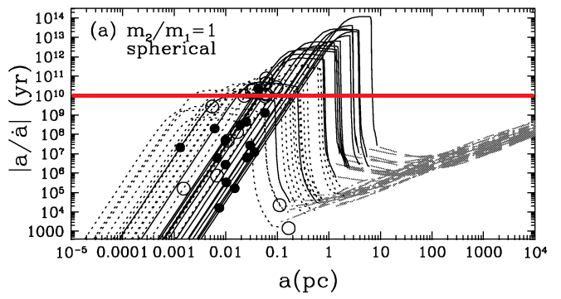
The Last Parsec Problem
At parsec separations there are too few star scattering to keep hardening de binary at time scales within a Hubble time.
Observationally, there are only a few SMBH binary candidates.
Apparently stars fail to produce a merger.
Yu 2002

Slide 6
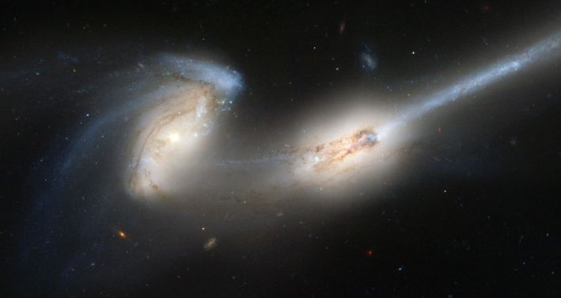
Effect of Gas
Interaction with gas can still drive the SMBHs to lower separations.
When two galaxies merge there are large amounts of gas funnelled to the center of the remnant.
More effcient absorbing the angular momentum of the binary than stars.

Slide 7
Prograde Discs
The interaction of the binary with a prograde circumbinary disc has been studied by several authors with simulations (e.g. Armitage & Natarajan 2005; Cuadra et al. 2009; Lodato et al. 2009).
Very inefficient for higher binary masses.
Armitage & Natarayan 2005

Slide 8
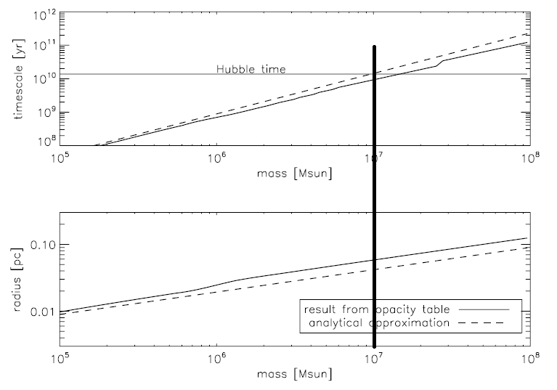
Cuadra et al. 2009

Slide 9
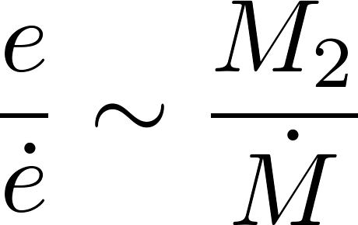
Retrograde Discs
Nixon et al. (2011a,b, 2013) showed that a counter-aligned disc interact much strongly with the binary.
Absence of resontant gravitational torques.
Eccentricity growth timescale

Slide 10
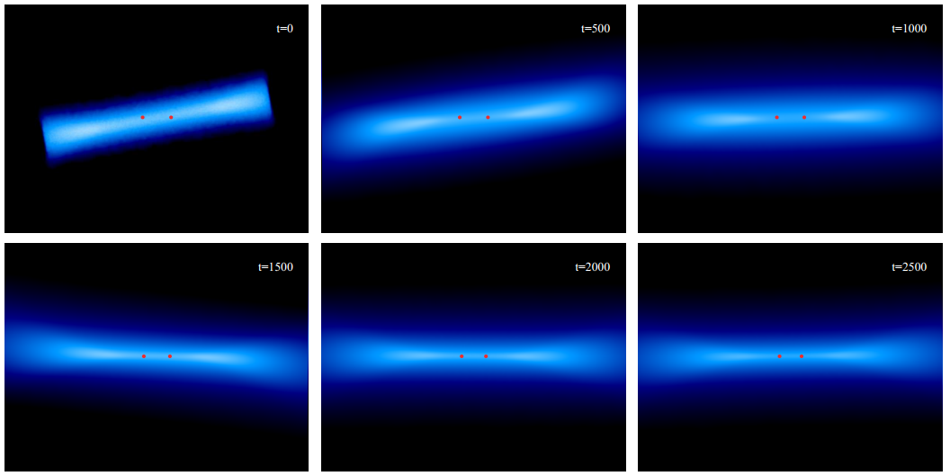
Prograde vs. Retrograde
Nixon (2012) studied discs formed with random orientations.
A chaotic accretion event will result in a disc either prograde or retrograde.

Slide 11
Gas-rich merger and BH accretion
During a galaxy merger the large scale gas and the binary are somewhat aligned (Dotti et al. 2006).
Turbulence on the nuclear component (Mayer et al. 2007) can produce accretion without any strong preferential direction.
“Chaotic accretion scenario” (King & Pringle 2006)
Mayer et al. 2008

Slide 12
Simulation of Hobbs et al. (2011) to quantify the importance of velocity dispersion in the gas at relatively large distances from the BH.
“Ballistic accretion”
Turbulence randomize the direction of the accretion events.

Slide 13
Motivation
One possible answer for the last parsec problem is the interaction with a circumbinary disc. However, the formation mechanism is still unclear.
There have been several studies about the star formation at the Galactic Center (e.g. Bonell & Rice 2008, Hobbs & Nayakshin 2009, Mappelli et al. 2012, Lucas et al. 2013) attempting to explain the particular distribution of stars.
Common ground: Gas falling towards Sgr A* with low impact parameter (pericenter distance)

Slide 14
Bonnell & Rice 2008

Slide 15
Goals
Model evolution of a cloud interacting with SMBH(s).
Measure gas alignment.
Follow evolution of gas.
Quantify orbit evolution.
Determine observational signatures.
Measure the effect of magnetic fields.

Slide 16
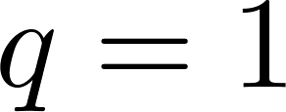
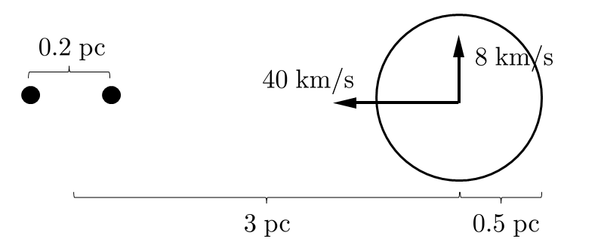
Work done during 2013
Cloud
Black Hole Binary
Initially turbulent, uniform density and temperature of .
Circular, keplerian orbit
Simulation run using SPH code GADGET-3
Pericenter distance

Slide 17
Aligned Orbits

Slide 18
Time evolution of the angular momentum direction for the mini-discs

Slide 19
Perpendicular Orbits

Slide 20
Time evolution of the angular momentum direction for the mini-discs

Slide 21
Work-plan: 2014
Explore the parameter space:
Turbulence, thermodynamics, physical features of the binary and the cloud, cloud orbit.
Determine torque and BH spin evolution provided by accreted particles.
Measure the binary orbit evolution.
Determine possible observational signatures.
Investigate the implications of spin misalignment.
Present results on conferences and with publications.

Slide 22
Work-plan: 2015
Run same configurations as before including Magneto-Hydrodynamic simulations (collaboration with F. Stasyszyn)
Write final report of the thesis.

Slide 23
Collaborations
Dr. Alberto Sesana (Albert Einstein Institute, Potsdam-Golm, Germany): study the alignment of the gas with the binaries and gravitational wave emission
Dr. Federico Stasyszyn (Leibniz-Institut für Astrophysik, Potsdam, Germany): development of an MHD code that can model the evolution of a cloud/SMBH system.
Dr. Alex Dunhill (IA, PUC): compare the results of a cloud with larger impact parameters.

